Slide 1
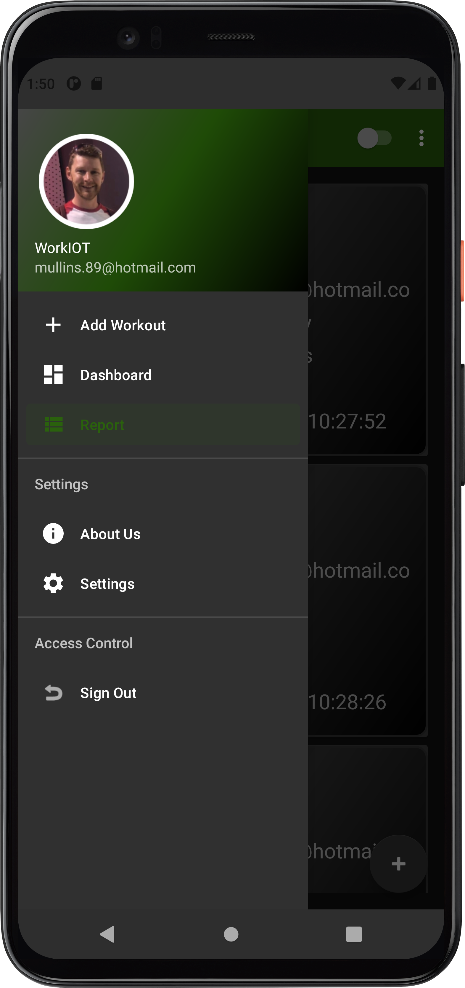
WorkIOT
Resistance training analysis & reporting
system
Ian Mullins - 20034981

Slide 2
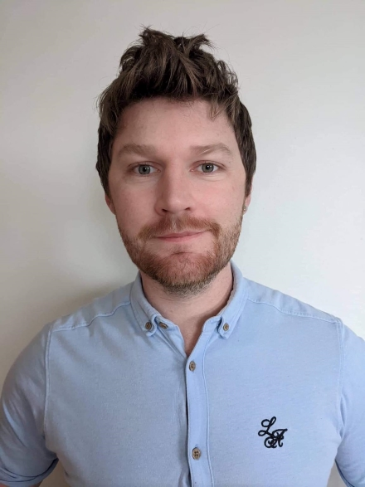

Ian Mullins 20034981
iamianmullins@gmail.com
https://github.com/iamianmullins
https://www.linkedin.com/in/mullinsian/
https://iamianmullins.github.io/

Slide 3
Goals and Justification
This was a personal interest project which ensured maximum motivation.
Aim to make resistance training more efficient by leveraging technology to enforce good lifting practices.
The number of people utilizing wearable technology continues to grow. Expected to hit 30.9m by 2025.
Free weight/resistance training accounts for a large amount of workout related injuries.
Most resistance training injuries can be attributed to overexertion/strenuous or unnatural movements.

Slide 4
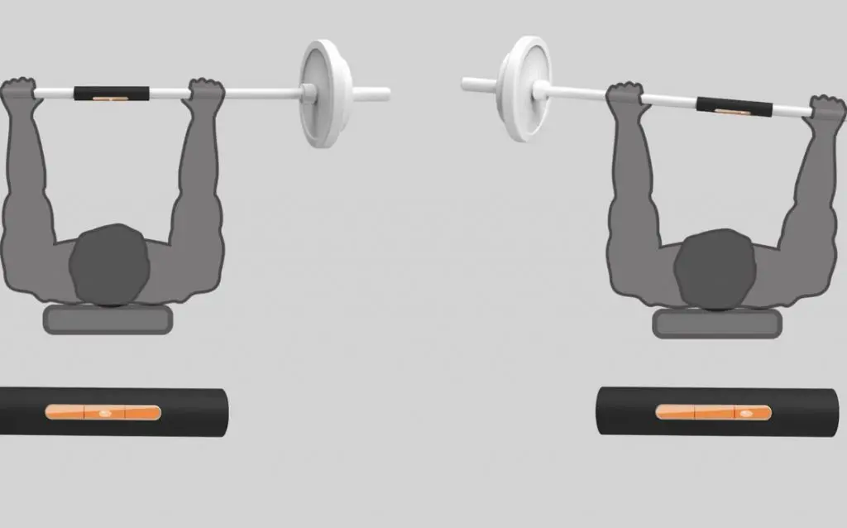
Goals and Justification
Aim to make workouts more productive and accelerate progress.
Aim to reduce injury risk as a result of improper lifting technique.
Aim to reduce guesswork and bridge knowledge gaps in resistance training program development.

Slide 5
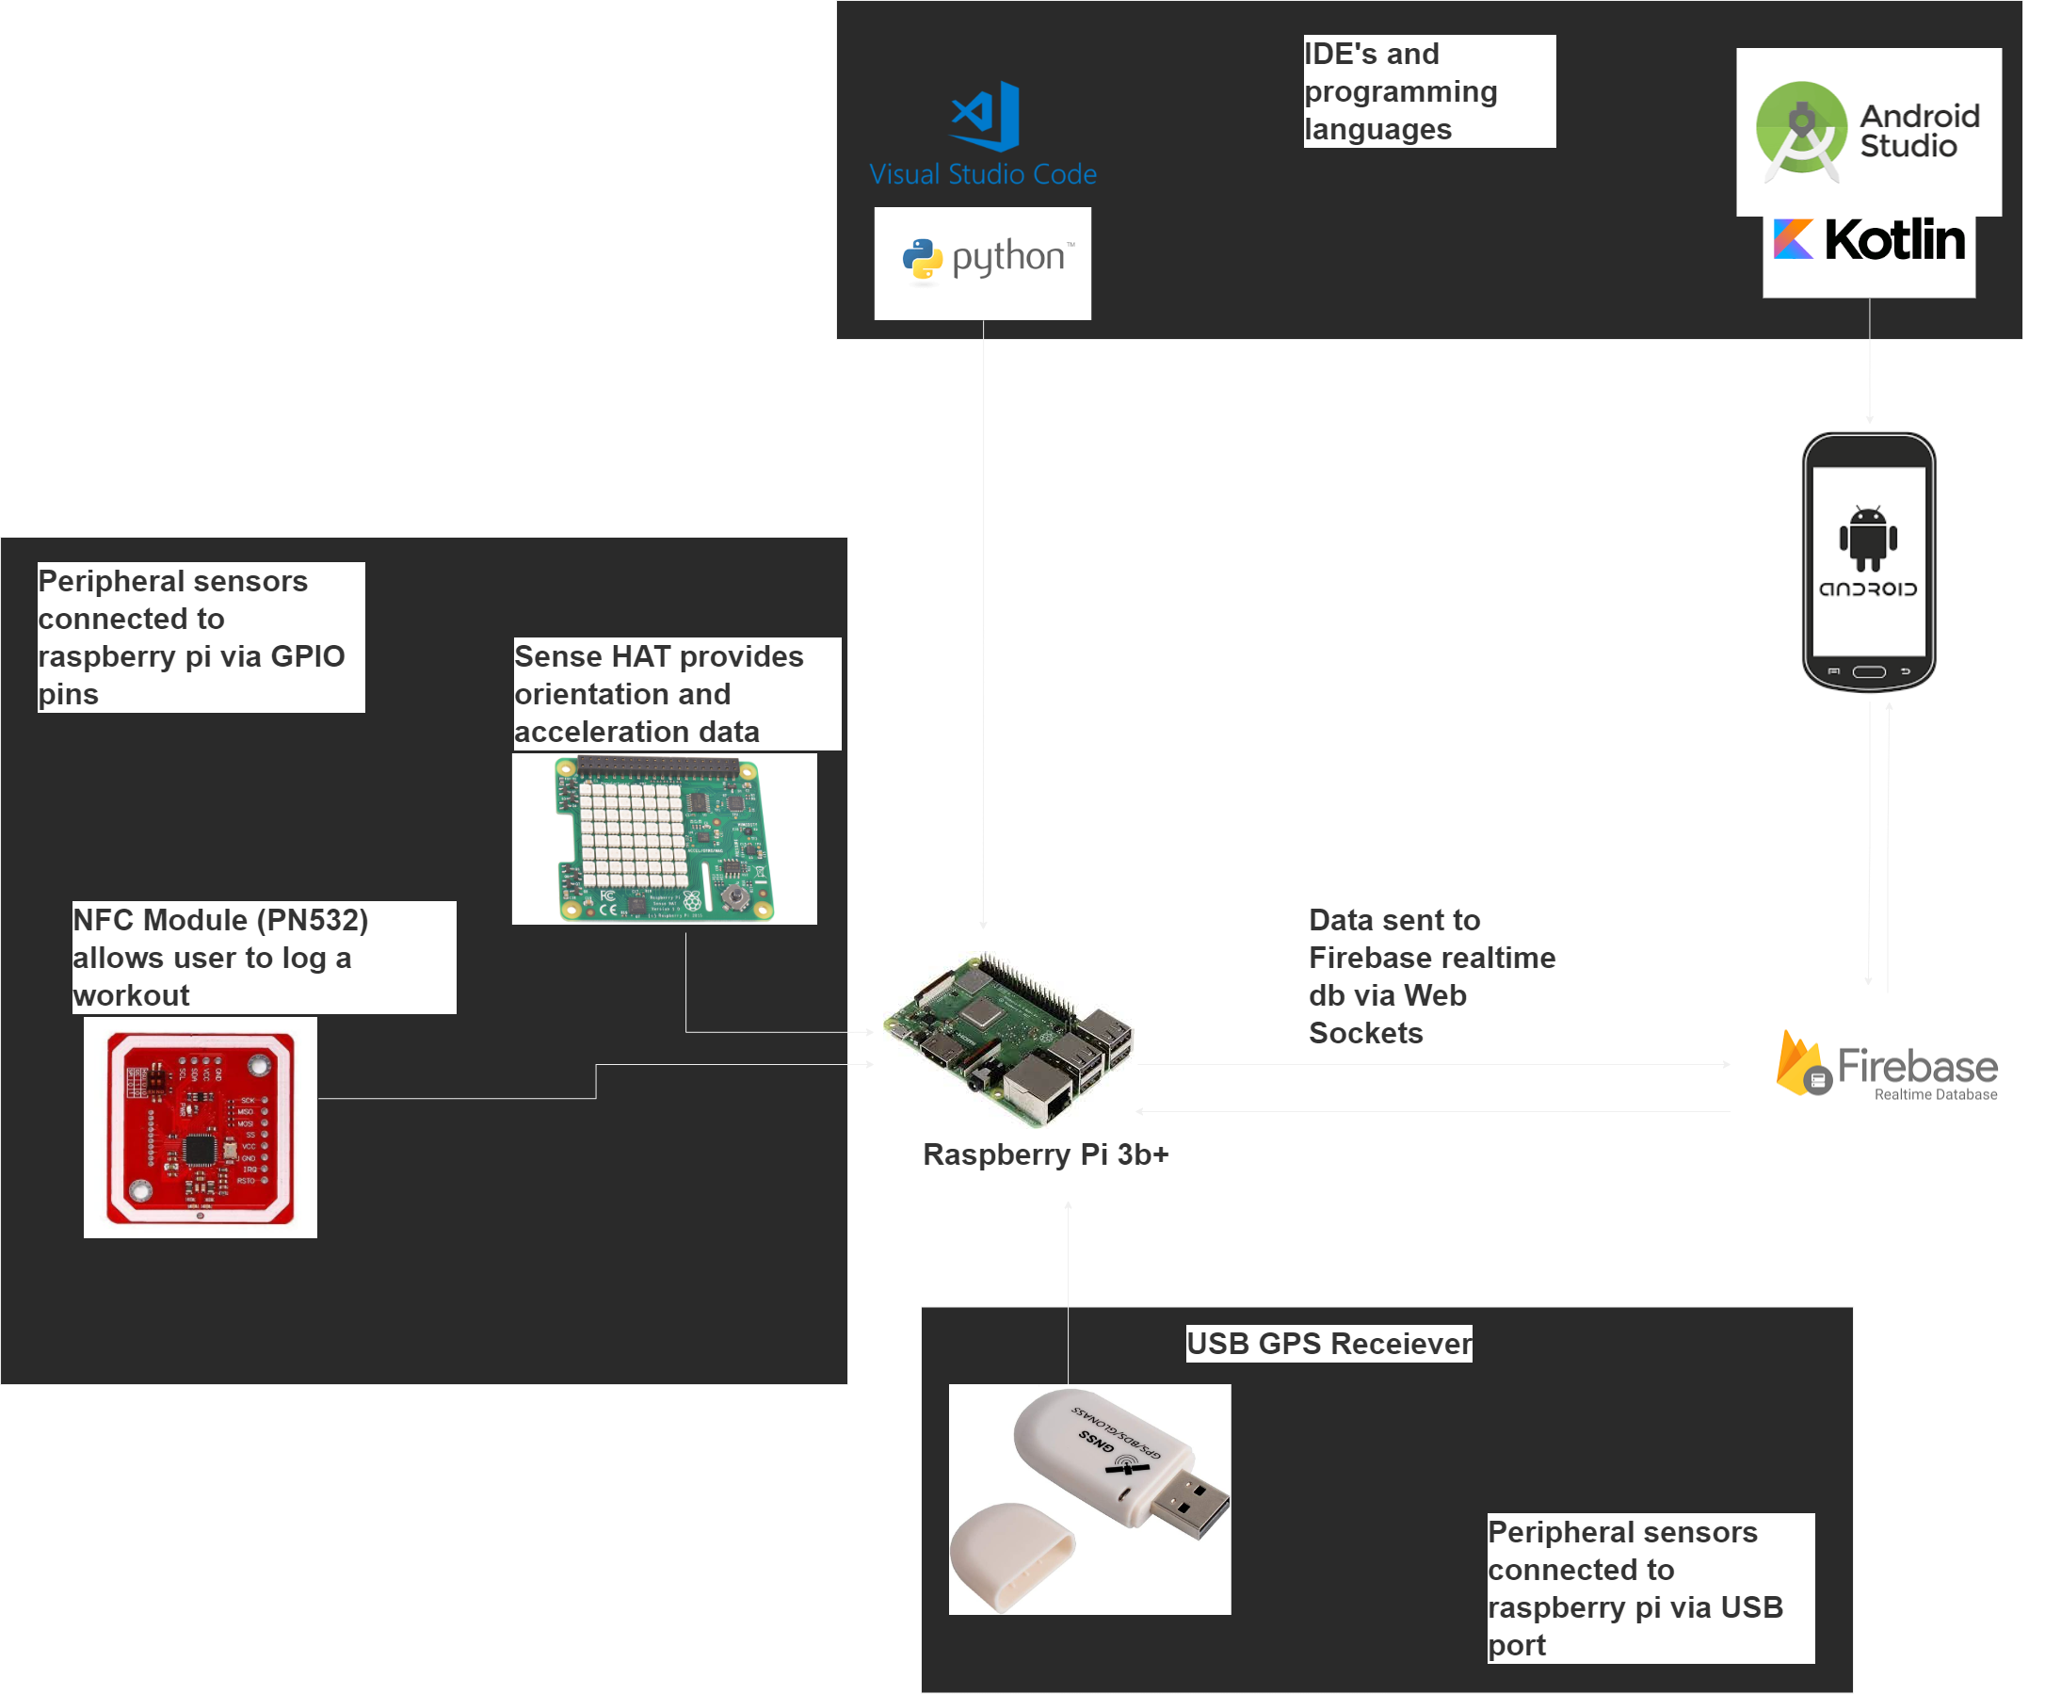
Architecture Diagram
WorkIOT is a resistance training analysis and reporting IOT system. The project ecosystem is comprised of an Android mobile app and raspberry pi device with sensors attached. It was developed as a tool to enhance training performance, but also reduce risk of injury.

Slide 6
Deliverable timeline
Generate user data
Produce a working minimal viable product via the hardware components which can generate user data.
IOT firebase connectivity
IOT device firebase integration for data persistence and potential clients.
Android app, basic functionality
A working android application for tracking exercise progression.
Android app firebase connectivity
Firebase integration and persistence for the android application.
Complete project ecosystem whereby the mobile application and IOT device communicate.
Complete project ecosystem

Slide 7
Technologies used
Android Studio – Kotlin Development
Visual Studio Code – Python Development
GIT Command line – GIT management
Firebase Realtime Database
Trello task management tool
Adafruit_CircuitPython_PN532 Library
Gpsd client Python libraries

Slide 8
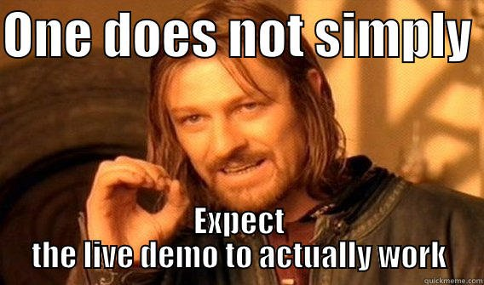
Live Demo!! https://www.youtube.com/watch?v=hHUb3OTjGcg

Slide 9

Learnings, Problems & Future Plans

Slide 10

Learning and key takeaways
Deeper dive into Android application development.
Greater familiarity with GIT command line.
Deeper understanding of communication protocols and hardware integrations.
Task management, importance of sizing estimates.
Task management and prioritization with impending deadlines.

Slide 11

Problems Encountered
Hardware selection, expanding resource requirements.
NFC integration uncertainty.
Cron job not running at reboot.
Malfunctioning hardware, Pn532.

Slide 12

Future Plans/Iterations
Android app newsfeed implementation which should provide a social networking component.
Android app map view to compliment social networking enhancements.
UI/UX refinement and enhancements following user feedback.
Improvements in device form factor.
Implementation of a more appropriate information screen.

Slide 13

Thank You
Questions?
Ian Mullins
iamianmullins@gmail.com
https://iamianmullins.github.io/

